Slide 1
GETTING STARTED WINLINK EXPRESS USING WINMOR
2019 New England Division Convention - Boxborough, MA
GEORGE BLAKESLEE – N1GB SEPTEMBER 6, 2019
WINLINK GLOBAL RADIO EMAIL

Slide 2
Agenda
Overview
Digital Communication
4-Part Presentation (1 hour @)
Winlink RF/internet email
NBEMS FLDIGI
NBEMS FLMSG & FLAMP
Advanced Topics, Hints, Kinks

Slide 3
A Winlink Express Station (using the Winmor sound card modem)

Slide 4
WINLINK SYSTEM

Slide 5
PEER TO PEER (P2P)

Slide 6
RF NETWORK

Slide 7
SYSTEM REQUIREMENTS
Microsoft-supported 32 or 64 bit Windows OS (Windows 10, Windows 7 or Windows 2003 Server, or later), or under Windows on Apple Mac machines using a VM engine or dual boot arrangement.
We no longer recommend Windows XP for common support and security reasons, and we will not address technical problems that arise as this OS ages without Microsoft support.
The program makes minimal CPU demands with the exception of WINMOR operation. The heavy DSP demands of WINMOR require a computer of at least 700 MHz Pentium/Celeron class and at least 512 Meg of memory.
If multiple applications are running concurrently, we recommend a faster computer and more RAM.

Slide 8
DEFINITIONS
RMS - RADIO MESSAGE SERVER
"RMS Gateway" refers to any RMS station connected to one or more CMS (Common Mail Server) in the "cloud". Or, it can refer to an HSMM or D-Star gateway connecting to any CMS using the Telnet protocol. These stations are "gateways" to the CMS for user (client) stations.
The Common Message Servers (CMS) are the common coordinating engines at the heart of the Winlink 2000 "star" Network configuration.

Slide 9
WINMOR
Winmor is an HF digital soundcard mode designed primarily for use with the Winlink Express radio-email network. Winmor provides an alternative to expensive PACTOR hardware modems at speeds between Pactor 1 and 2.
Winmor, the Winmor software modem, and the WINLINK Express application were developed by Rick Muething, KN6KB and Vic Poor, W5SMM. The Winmor modem includes innovative features such as a “busy frequency” detector to reduce potential interference.

Slide 10
EmComm Usage
WINLINK Express may be used as a client for emergency communications.
It has some special features for EmComm, such as HTML/CSS forms creation and formless content transport, plus a library of pre-created forms to use.
Before adopting WINLINK Express as your program for EmComm, please check with your local EmComm group for their plans.
This may be your ARES, RACES, MARS etc. organization that will be responsible for providing training and support.

Slide 11
Download Winlink Express
From https://www.winlink.org/WinlinkExpress
Winlink_express_install_1-4-4-0.zip
From http://www.greg-hand.com/versions/
itshfbc_161207.exe

Slide 12
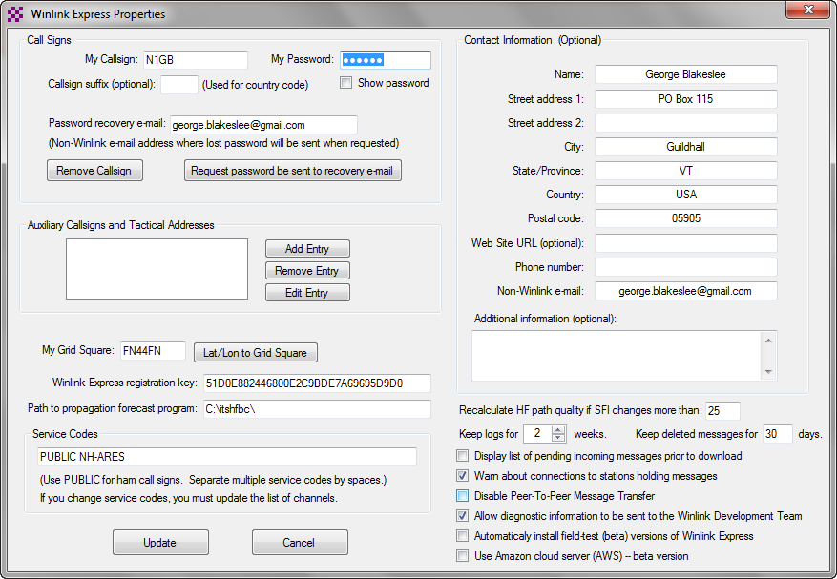
WINLINK EXPRESS SET-UP

Slide 13
GET A WINLINK ACCOUNT
Winlink Accounts...
...are created with a client program.
We require
A valid amateur radio license
How To Get an Account
Download, install and configure Winlink Express.
Using Winlink Express, follow the account creation instructions presented by the program
Winlink accounts stay alive only with client program use via radio or telnet connections only; Webmail and other accesses don't count!). Accounts off-air for 400 days are automatically purged. Use it or loose it!

Slide 14
GET A WINLINK ACCOUNT
Download, install and configure Winlink Express.
Using Winlink Express, follow the account creation instructions presented by the program, and ignore what follows. Winlink Express makes the process easy. If you use another client, proceed...
Connect with the system (send a message) to create your account. Do not use a password on your first connection. Your radio email address is YOURCALL@winlink.org. A message containing your password will be sent to your account. Retrieve it with a second connection. Secure login will now be enforced by the CMS so, be sure to set your password in your client program.
At any time, use the form at http://www.winlink.org/user to have a password re-sent to your account address. Retrieve it using your client program.
Use your callsign as your username, and password to log in here. You can change your password once you're logged in.
Be sure to edit your account settings here and set a password recovery address!

Slide 15
LIVE DEMO OUTBOUND & INBOUND (TELNET) CONNECTION

Slide 16
PREFERENCES

Slide 17
BEST CHANNEL SET-UP

Slide 18
WINLINK EXPRESS MAIL BOX

Slide 19
WINLINK EXPRESS SENT MAIL

Slide 20
MESSAGE SIZE

Slide 21
NEW MESSAGE

Slide 23
COMPOSE A MESSAGE

Slide 24
OUTBOX

Slide 25
CHECK WINMOR CAPTURE AND PLAYBACK DEVICE

Slide 26
PERFORM TX LEVEL TEST AND ADJUST ALC USING SIGNALINK TX KNOB

Slide 27
CHECK INCOMING RX LEVEL AND ADJUST INTO GREEN IF NECESSARY

Slide 28
ALLOW WINLINK CHANNEL PROPAGATION INDICES TO UPDATE IF USING INTERNET CONNECTION

Slide 29
SELECT A CHANNEL BASED ON PROPAGATION RESULTS

Slide 30
WAIT FOR CHANNEL TO BE CLEAR

Slide 31
START SESSION

Slide 32
OBSERVE SESSION

Slide 33
CHECK SENT ITEMS AND OUTBOX

Slide 34
VIDEO DEMO OUTBOUND & INBOUND (RF) CONNECTION [10 MIN]

Slide 35
P2P CONNECTION
1. WHEN COMPOSING MAIL CHECK “P2P”.
2. OPEN WINMOR P2P SESSION.
3. EVERYTHING ELSE IS THE SAME.
4. NOT A MULTICAST MODE.

Slide 36
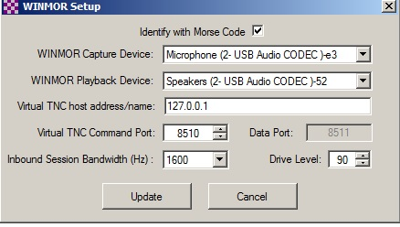
TROUBLESHOOT
1. RECHECK WINMOR TNC SET-UP

Slide 37
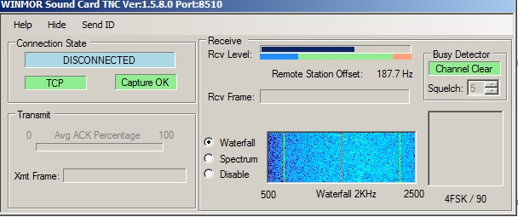
TROUBLESHOOT
2. CHECK TX AND RX LEVELS. WINMOR DOES NOT LIKE HIGH LEVELS.

Slide 38
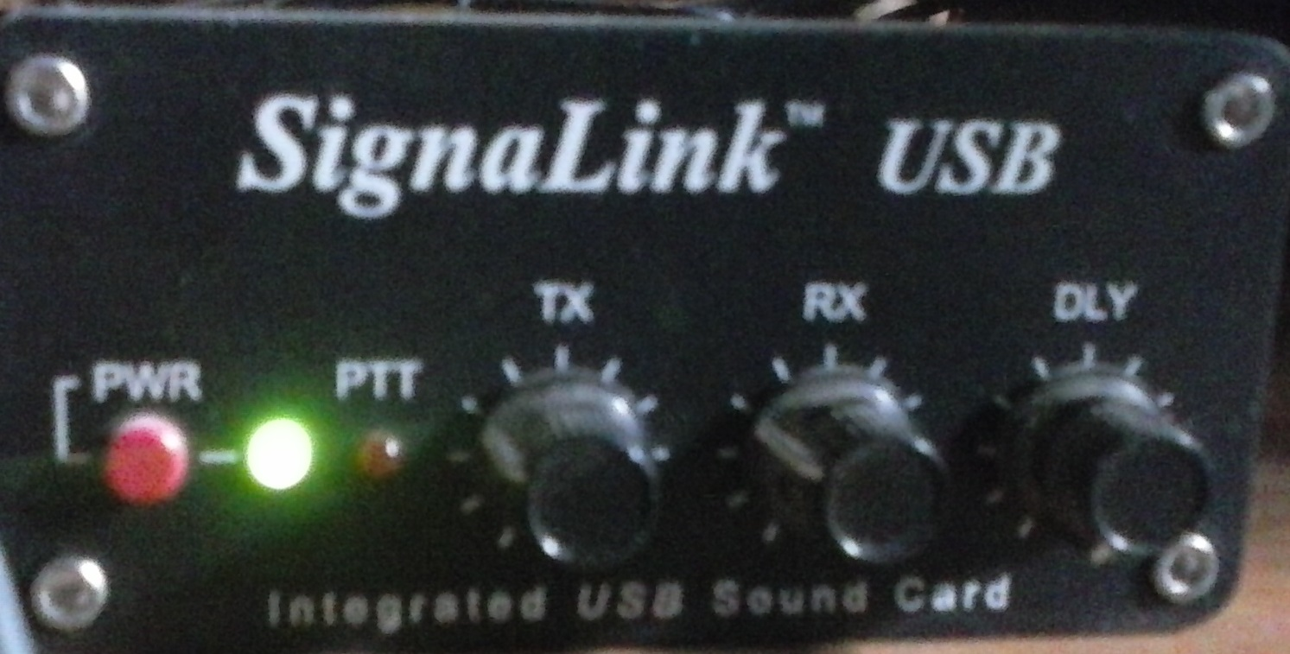
TROUBLESHOOT
3. DO NOT START RMS UNTIL SIGNALINK IS PLUGGED IN AND POWER IS ON.

Slide 39
USAGE AND UPDATES
ACCOUNTS MUST BE USED TO REMAIN ACTIVE. 400 DAYS INACTIVE AND THE ACCOUNTS EXPIRE.
UPDATE AS OFTEN AS POSSIBLE.
GET ON THE MONTHLY TEST LIST BY EMAILING ME AT george.blakeslee@gmail.com

Slide 40
Now get on the air!

